Slide 1
Information Processing Techniques
Week 04
Abeeha Sattar

Slide 2
XML Concepts and Implementation

Slide 3
XML Technology
Derived from SGML (Standard Generalized Markup Language)
Text-based format
Describes document structures using markup tags
Useful for describing document formats for Web
It is also useful for describing both structured as well as semi-structured data.
Notes:
Text-based format means that one can read and edit an xml document using standard text editing tools

Slide 4
Why XML?
Platform-independent
Can be run over any operating System
Can be processed using any programming language
Extensible:
No fixed vocabulary
Flexible, change the structure by adding new tags
Supports Global implementation being fully Unicode
No emphasis on display and rendering the XML document

Slide 5
XML Skeleton
Syntax similar to HTML
Start tag <start>
end tag </start>
Case sensitive
White spaces are preserved
Elements must be properly nested
XML Infoset
Information items which are abstract representation of components of an xml document
Up to 11 information items including Document, element, attribute, processing instructions etc.

Slide 6
XML Skeleton
Schema Languages
Used to describe the structure and content of xml document
During document interchange describes the contract between the producer and consumer application
DTDs, XDR, XSD
XML APIs
Tree-model API – (full tree in memory)
XmlDocument Class in .NET, DOM, SAX
Cursor-based API – lens on one node at a time
XPathNavigator Class in .NET (only required fields in mem.)
XmlCursor class from BEA's XMLBeans toolkit
Streaming API
SAX, XMLPULL,
Object to XML Mapping API
include JAXB, the .NET Framework's XmlSerializer and Castor.
Notes:
XSD = XML Schema Definition
DTD = Document Type Definition
XDR = eXternal Data Representation

Slide 7
XML Skeleton
XML Query
In some cases data extraction from XML documents through available APIs is difficult or all of the data can not be extracted.
XPath, XQuery
XML Transformation
XSLT is the primary transformation tool
There are various vendor tools available for transforming XML to HTML, PDF, WORD, RTF etc.
Notes:
XSLT = eXtensible StyleSheet Language Transformations
The XML Path Language (XPath) is used to uniquely identify or address parts of an XML document. An XPath expression can be used to search through an XML document, and extract information from any part of the document, such as an element or attribute (referred to as a node in XML) in it. XPath can be used alone or in conjunction with XSLT.
XQuery (XML Query) is a query and functional programming language that queries and transforms collections of structured and unstructured data, usually in the form of XML, text and with vendor-specific extensions for other data formats (JSON, binary, etc.).

Slide 8
Uses of XML
Traditional data processing
XML encodes the data for a program to process
Document-driven programming
XML documents are containers that build interfaces and applications from existing components
Archiving
Foundation for document-driven programming, where the customized version of a component is saved (archived) so it can be used later
Binding
DTD or schema that defines an XML data structure is used to automatically generate a significant portion of the application that will eventually process that data

Slide 9
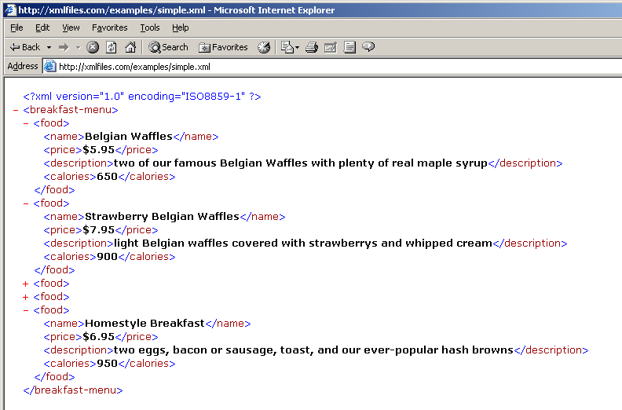
Schema

Slide 10
XSD
<?xml version="1.0"?> <xs:schema xmlns:xs="http://www.w3.org/2001/XMLSchema"> <xs:element name="note"> <xs:complexType> <xs:sequence> <xs:element name="to" type="xs:string"/> <xs:element name="from" type="xs:string"/> <xs:element name="heading" type="xs:string"/> <xs:element name="body" type="xs:string"/> </xs:sequence> </xs:complexType> </xs:element> </xs:schema>

Slide 11
XML in .NET Framework
.NET Applications
ASP. NET Web Applications
Windows Forms Applications
ASP. NET Web Services
Windows Services
.NET Framework Base Classes
ADO. NET
XML
SECURITY
NETWORK
MESSAGING
WINFORMS
WEB
Etc…
.NET Applications
Memory Management
Object Life Cycle Management
Common Type System
JIT Compilers
Operating System
MACHINE

Slide 12
XML .NET Architecture
XML is extensible in the .NET Framework (extending the existing classes)
In the .NET Framework XML has a pluggable architecture.
Pluggable ~ abstract classes can be easily substituted
Pluggable ~ Data can be streamed between components and new components can be inserted that can alter the processing of the document

Slide 13
Pluggable Architecture
Developer can create new classes by extending the existing ones
Can introduce new features and thus changes the behavior of existing ones
e.g. create MyXmlTextReader extending the XmlTextReader class which converts an attribute-centric document to an element-centric document

Slide 14
XML.NET Classes & Namespaces
The Framework has several XML classes that allow working with XML documents and data
These classes are the core elements of .NET Framework
Most of the XML classes are contained in the System.Xml namespace.
The term namespace refers to a logical grouping of the classes designed to implement a specific functionality.

Slide 15
Hierarchy
System.Xml Namespace
XmlReader
XmlDocument
XMlWriter
XmlElement
XmlNavigator
XmlAttribute
System.Xml.XPath
System.Xml .Xsl
System.Xml.Serialization
System.Xml Schema

Slide 16
XML Parsing
Parsing in .NET
Pull Model
DOM

Slide 17
XmlReader Class
XmlReader
XmlTextReader
MoveTo()
Read()
XmlNodeReader
XmlValidatingReader
XmlReader – Abstract Class
XmlTextReader – Reads text based stream, non-cached, read-only
XmlNodeReader – Reads in memory DOM tree
XmlValidatingReader – validates with DTD, XDR XSD schemas

Slide 18
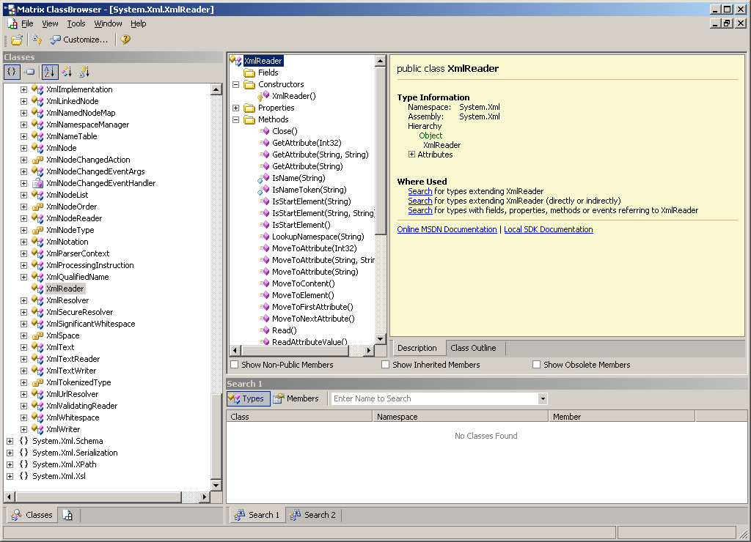

Slide 19
XmlReader Example
XmlReader reader;
Reader = new XmlTextReader(“test.xml”);
While(reader.Read()){
/*
Your processing code here
*/
}

Slide 20
XmlWriter Class
XmlWriter
XmlTextWriter
MoveTo()
Read()
XmlNodeWriter
XmlWriter writer = new XmlTextWriter();
writer.WriteStartDocument();
Writer.WriteStartElement(“name”, “Ahmed”);

Slide 21
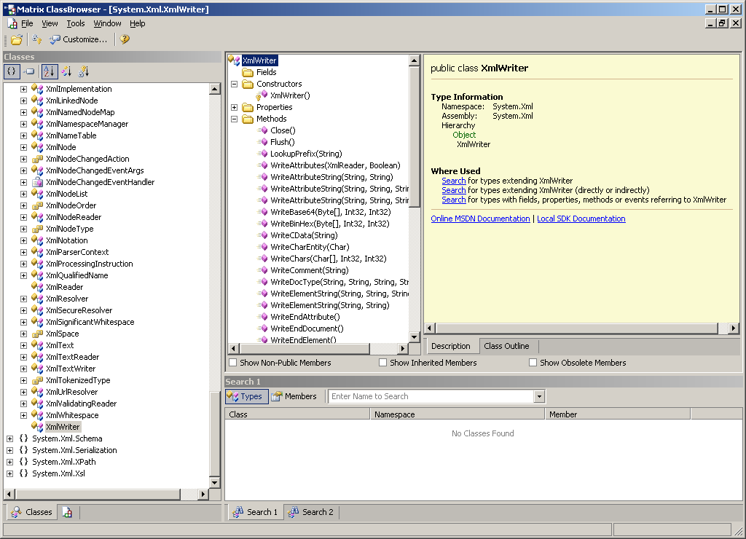
XmlWriter Class Overview

Slide 22
XmlDocument (DOM)
XmlDocument
XmlNodeList
XmlNamedNodeMap
XmlNodeList – Collection of Different Xml Nodes
XmlNamedNodeMap – collection of Attributes
Methods
Load
LoadXml
Save

Slide 23
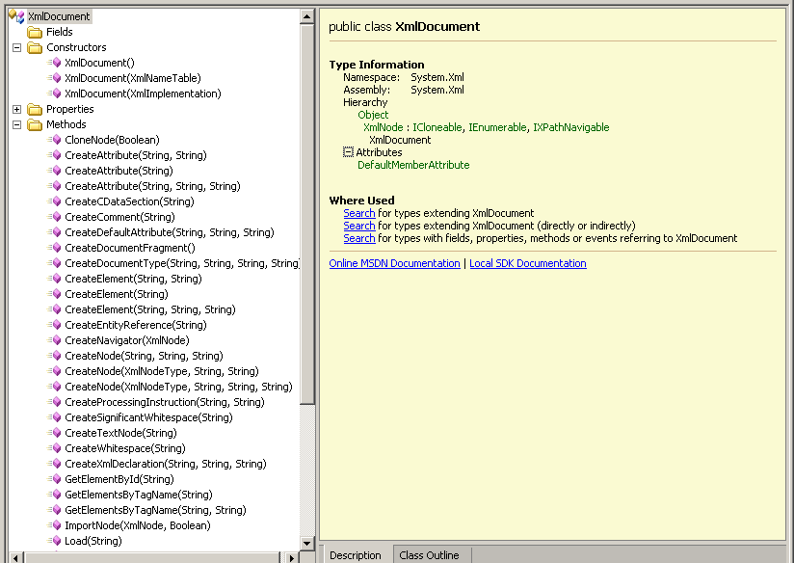

Slide 24
Xpath Query in .NET
Used to specify query expressions to locate nodes in XML document
Used in XSLT stylesheets to locate and apply transformation to specific nodes in an XML document
Used in DOM code to locate and process specific nodes in an XML document

Slide 25
XML and ADO.NET
In .NET Framework tight integration has been introduced between XML classes and ADO.NET
The DataSet components are able to read and write XML using XmlRead and XmlWrite Classes
There is a synchronization between XmlDocument and DataSet, which enables automatic update
XmlDataDocument (extension of XmlDocument) provides a bridge between relational and hierarchical data

Slide 26
Serialization
What is Serialization?
System.Serialization
Scenarios in Serialization
Basic Serialization
Custom Serialization

Slide 27
Serialization/Deserialization
Object in memory
…binary or character stream…
Object in memory
Notes:
Serialization = writing the object’s state out in serial (sequential) order to a stream of some sort.
DeSerialiation = reading the object state back in from the stream to restore it.
This is all about state, although structure is important too. If I serialize things ABC, and you deserialize them expecting CBA, we’re in trouble.
XML is particularly neat for serialization because it’s self-describing.

Slide 28
Serialization What is Serialization
Serialization is the process of converting an object, or a connected graph of objects, stored within computer memory, into a linear sequence of bytes
Use the sequence of bytes in several ways:
Send it to another process
Send it to the clipboard, to be browsed or used by another application
Send it to another machine
Send it to a file on disk
Notes:
Let's clearly define what we mean by serialization. By Serialization we mean converting an object, or a connected graph of objects, stored within computer memory, and conventionally drawn on paper in two dimensions, into a linear sequence of bytes. That string of bytes contains all of the important information that was held in the objects we started with.
We can go on to use that sequence of bytes in several ways. For example:
Send it to another process (on the same machine) and use it to construct arguments to a method that is run in that other process. In this case, the sequence of bytes is copied from one location in the machine's physical memory to another – it never leaves the machine
Send it to the clipboard, to be browsed or included in another application. As above, the sequence of bytes is transferred to another location in memory on the current machine.
Send it 'down the wire' to another machine and use it to create a clone on that machine of the original object graph. As above, we might then use this object graph as an argument to a method call. In this case, however, the sequence of bytes is actually transferred outside of the originating machine.
Send it to a file on-disk, so that it can be reused later. (See, for example, the classic "Scribble tutorial" in "Using Visual C++" issued as part of the Visual C++ 6.0, and earlier).

Slide 29
Serialization Object Graph
What is an object graph?
An object graph is a set of objects with some set of references to each other
The most obvious problem is how to represent the links between the objects in the Serialized stream
3
Dog
4
Cat
7
Cat
1
Mouse
9
Horse
2
Duck
Notes:
An object graph is a set of objects with some set of references to each other. The interesting question here is what problems does this bring for Serialization? The most obvious problem is how to represent the links between the objects in the Serialized stream. After all, the value held in the field of the in-memory object which links to another object is essentially a 32-bit address, which has meaning only in the owner address space (and may even change, 'beneath our feet', due to garbage collection). Serialization needs to allocate each object in the stream a number. So, for example, we have assigned arbitrary, small numbers to objects below, and shown the class of each:
Then we can represent this graph of objects with a serialized stream like this:
Dog, 3, ref 4, ref 7, ref 1 || Cat, 4 || Cat 7 || Mouse, 1, ref 9, ref 2 || Horse, 9, ref 4 || Duck, 2

Slide 30
Serialization How Serialization Works
Because run-time metadata 'knows' about each object's layout in memory, and its field and property definitions, you can serialize objects automatically, without having to write code to serialize each field
The serialized stream might be encoded using XML, or a compact binary representation
The format is decided by the Formatter object that you call:
Binary
SOAP
Custom
Notes:
Because the runtime metadata 'knows' all there is to know about each object's layout in memory, its field and property definitions, you can serialize objects automatically, without having to write code to serialize each field.
The serialized stream might be encoded using XML, or a compact binary representation. The format is decided by the the Formatter object that you call. Pluggable formatters allow the developer to serialize objects in with the two supplied formats (binary and SOAP) or create their own.
Serializetion can take place with any stream, not just a FileStream (see MemoryStream, NetStream, etc.)
Serialization makes use of several classes, as follows:
Formatter — Responsible for writing object data in some specified format to the output stream. This class is also responsible for driving the deserialization operation.
ObjectIDGenerator — ObjectIDGenerator generates IDs for objects. It keeps track of objects already 'seen' so that if you ask for the ID of an object, it knows whether to return its existing ID, or generate (and remember) a new ID.
ObjectManager — Keeps track of objects as they are being deserialized. In this way, deserialization can query the ObjectManager to know whether a reference to an object, in the serialized stream, refers to an object that has already been deserialized (a backward reference), or to an object that has not yet been deserialized (a forward reference).
Each of these components is 'pluggable' — the programmer can provide alternatives

Slide 31
Serializaiton FileStream Example
class SerializeExample{
public static void Main(String[] args)
{
ArrayList l = new ArrayList();
for (int x=0; x< 100; x++) {
l.Add (x);
} // create the object graph
FileStream s = File.Create("foo.bin"); // create the filestream
BinaryFormatter b = new BinaryFormatter();
// create the BinaryFormatter
b.Serialize(s, l);
// serialize the graph to the stream
} // end main
} // end class
Notes:
This example shows how to perform default Serialization of a graph of objects, whose root is the arraylist l. This code serializes the graph to a FileStream:

Slide 32
Serializaiton Deserialize Example
using System; using System.IO;
using System.Collections;
using System.Serialization;
using System.Serialization.Formatters.Binary;
class DeSerialize
{
public static void Main(String[] args) {
FileStream s = File.Open("foo.bin"); // open the filestream BinaryFormatter b = new BinaryFormatter(); // create the formatter ArrayList p = (ArrayList) b.Deserialize(s); // deserialize
p.ToString(); // print out the new object graph
} // end Main
} // end Class DeSerialize
Notes:
This example shows how to perform default Serialization of a graph of objects, whose root is the arraylist l. This code serializes the graph to a FileStream:

Slide 33
Serialization Basic Serialization
A Type is NOT Serializable unless Type is specifically marked as Serializable
The Serializable Attribute
The Non-Serializable Attribute
[Serializable] public class MyClass {}
[Serializable] public class MyClass {
[NonSerialized] int _cashSize;
}
Notes:
Class authors need to be aware of serialization. The serialization services assume that a type is NOT Serializable unless type is specifically marked as Serializable. In the most simple case marking a class as Serializable is the all the class author will have to do. For slightly more complex classes with state that is invalid to serialize, we provide support for marking those fields and properties as transient. For the handful of classes that need to participate in their own serialization an Deserialization we provide an ISerializable interface.
A class must be marked with the Serializable bit to be Serialized. An exception is thrown during serialization if the bit is not set of any class involved in the graph being serialized.
In C#, this bit is set with a reserved custom attribute
[Serializable] public class MyClass {} Classes with this attribute have all fields (even private ones) serialized.
There are fields and properties on some types that it does not make since to serialize. Either for performance or correctness reasons the class author needs to tell the serialization service to "skip" these members. This is done by using the NotSerialized custom attribute. If the NonSerialized/NotSerialized attribute is set the class author is saying this field or property within a class should not be serialized. In C# this bit is set with the transient keyword
[Serializable] public class MyClass { [NotSerialized] int _cashSize; }

Slide 34
.NET Serialization Facilities
Take an extremely simple C# class:
public class InitialConfiguration
{
public enum Difficulty {hard, medium, easy};
public InitialConfiguration() { }
public Difficulty starting = Difficulty.medium;
}
Notes:
There’s nothing that indicates that this class can be serialized, but…

Slide 35
.NET Serialization Facilities
Use .NET library functions to serialize it:
InitialConfiguration conf = new InitialConfiguration();
XmlSerializer ser = new XmlSerializer(typeof(InitialConfiguration));
XmlTextWriter writer = new XmlTextWriter(stream, System.Text.Encoding.UTF8);
ser.Serialize(writer, conf);
Notes:
… this code will serialize it.
This uses reflection, something familiar to Java programmers.
Stream = whatever stream we want to send this to.

Slide 36
.NET Serialization Facilities
Get XML:
<?xml version="1.0" encoding=“utf-8"?>
<InitialConfiguration
xmlns:xsd="http://www.w3.org/2001/XMLSchema"
xmlns:xsi="http://www.w3.org/2001/XMLSchema-instance">
<Starting>medium</starting>
</InitialConfiguration>
Notes:
Note that we didn’t need to do anything to the class which we’ve just serialized, and yet we get reasonable XML. All that’s required to serialize as XML or SOAP: Default constructor, and public data members or properties. (When in doubt, use properties.)
Don’t worry about the schema stuff; that’s boilerplate. You actually can omit it from your input XML files. But it’s better practice to use it.

Slide 37
Fin.

